Slide 1

Applied Project
Crop Wise
AI-Powered Tool for farmers.
Features crop analysis, soil analysis, recommendation system.
Team Members:
Ugochukwu Gabriel Ngene

Slide 2

Project Objectives
platform for FARMERS TO ASSESS CROP HEALTH, SOIL HEALTH
SECURE ACCESS TO PAST FARMER RECORDS. creation/update capability for USERS
AI decision-making based on ENTERED crop, soil, weather data.

Slide 3
Development Tools
Backend: C# ASP.NET, SQL
Frontend: Angular, Typescript
Testing tools: SwaggerUI
External APIs: AWS S3, Gemini 1.5 flash, OpenWeatherAPI

Slide 4

Features
UI Design: Landing Page, Login Page, AI Photo Crop Analyzer, Crop and Soil Records Workflow
JWT Authenticated Login
Ability to upload pictures of crop and get health analysis and recommendations.
Soil sample analysis/ recommender
Crop season plan recommendations based on real time weather/climate data

Slide 5
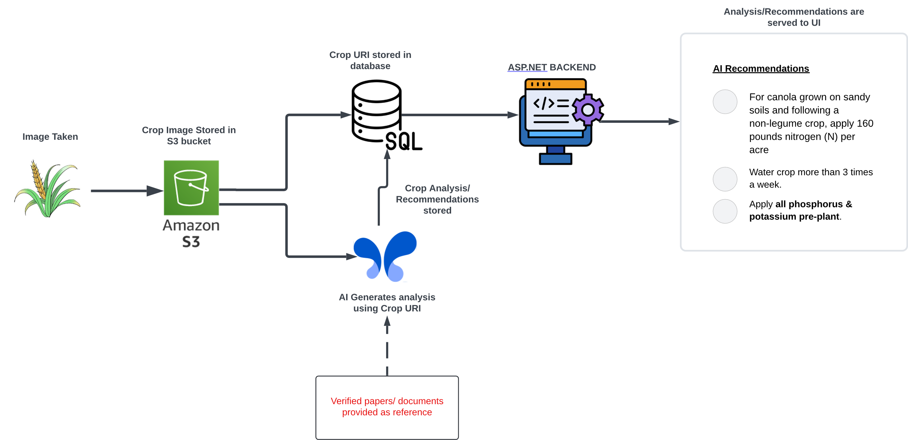
Crop Analysis WorkFlow
Farmers upload crop images, which are stored in an Amazon S3 bucket.
Gemini API analyzes the crop using verified agricultural papers as reference.
Analysis and recommendations are stored in the database and served to the UI.

Slide 6
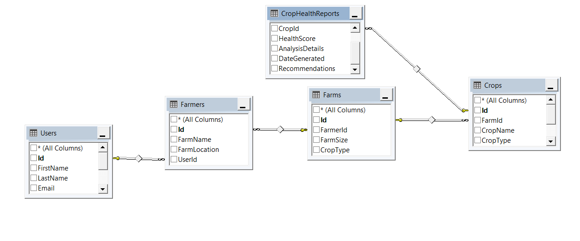
Backend progress (Database)
Database Schema
Tables:
Users
Farmers
Farms
Crops
CropHealthReports

Slide 7
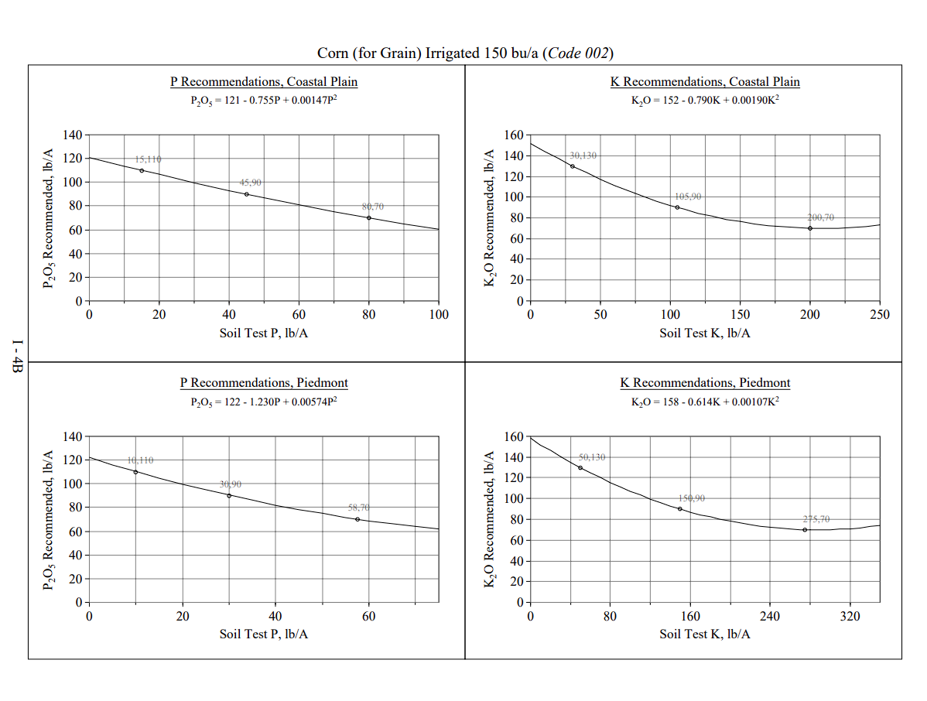
Soil Analysis (using verified papers as reference)
"Fertilizer Recommendations by Crops, Categorized“ by
The Agricultural and Environmental Services Laboratories (AESL) at the University of Georgia.
For each crop, the document provides specific nutrient requirements, often expressed in pounds per acre, to achieve optimal growth and yield.
Recommendations are based on soil test results, ensuring that nutrient applications are tailored to existing soil fertility levels.
Source: https://aesl.ces.uga.edu/publications/soil/cropsheets.pdf

Slide 8
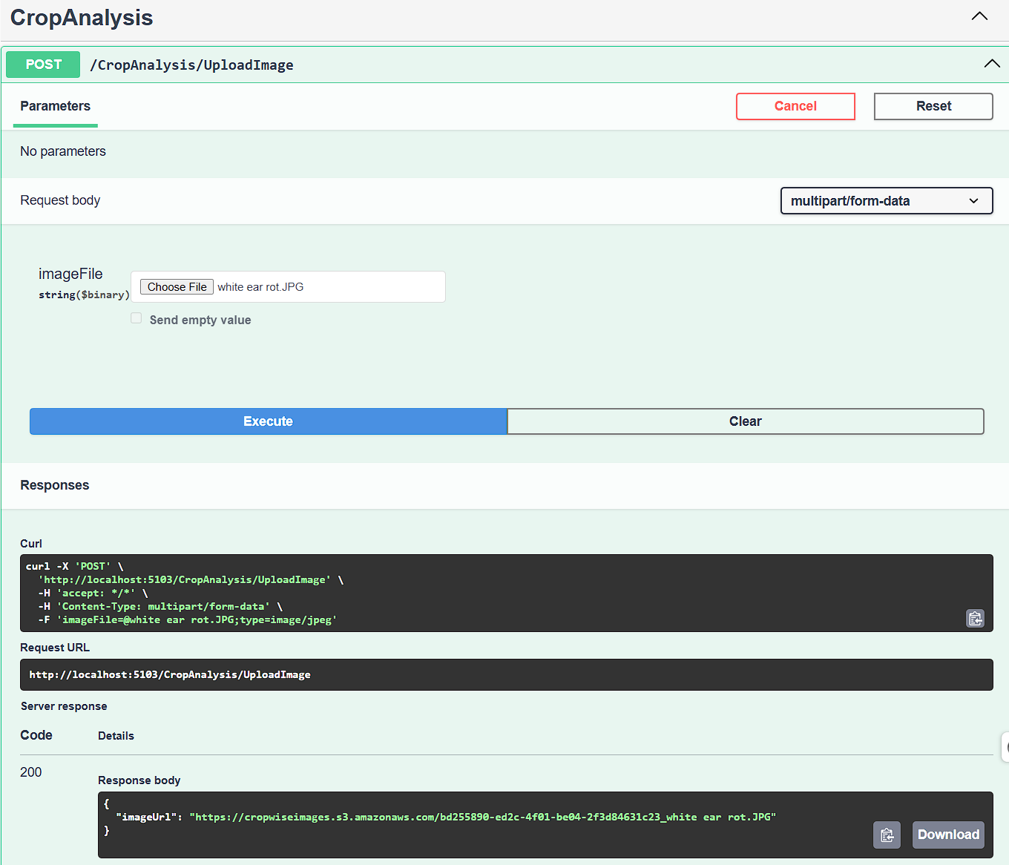
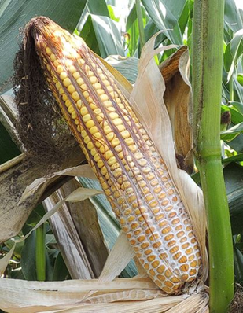
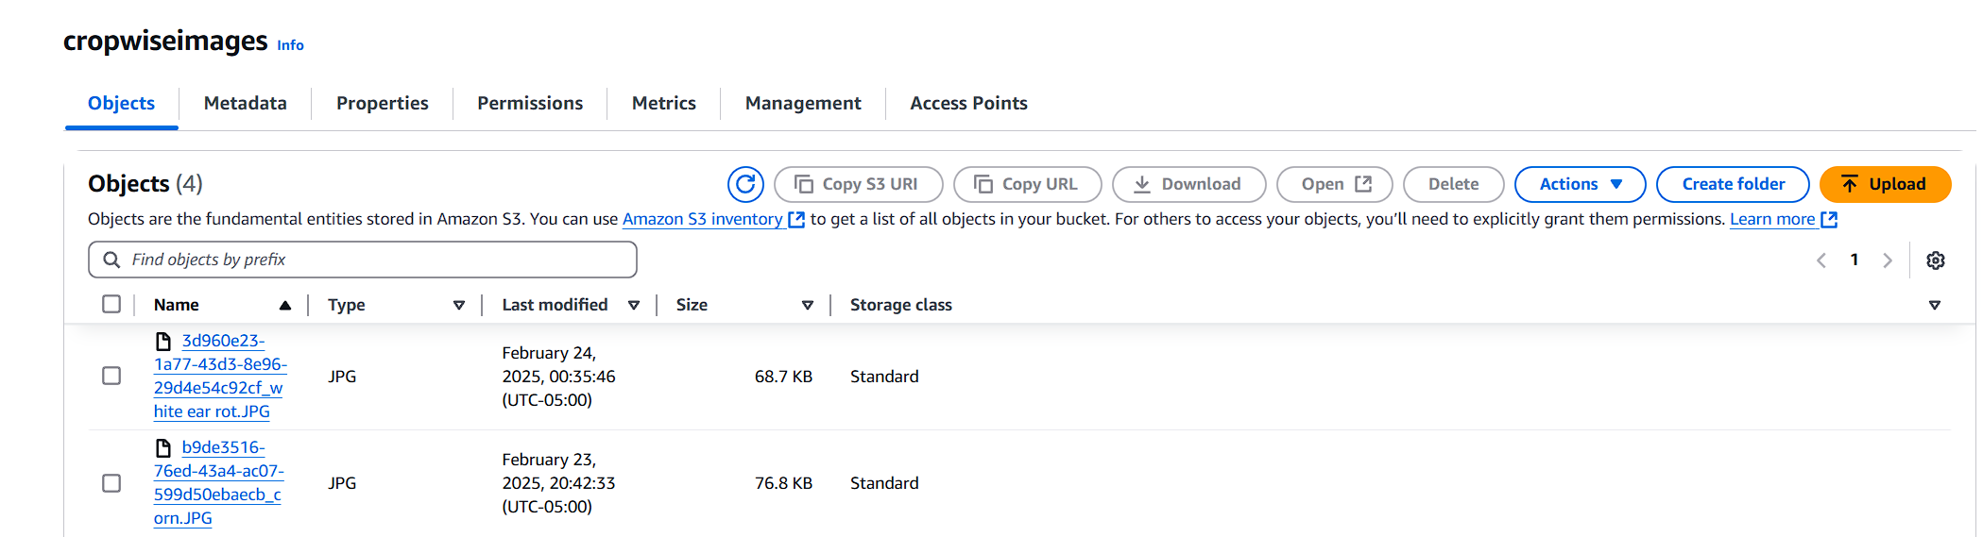
Backend progress (AWS s3 Bucket Storage)
Swagger UI Endpoint Testing
Corn cob with white ear rot infection
Crop image uploaded for testing
Code 200: Good response from s3 bucket storage
S3 Bucket

Slide 9


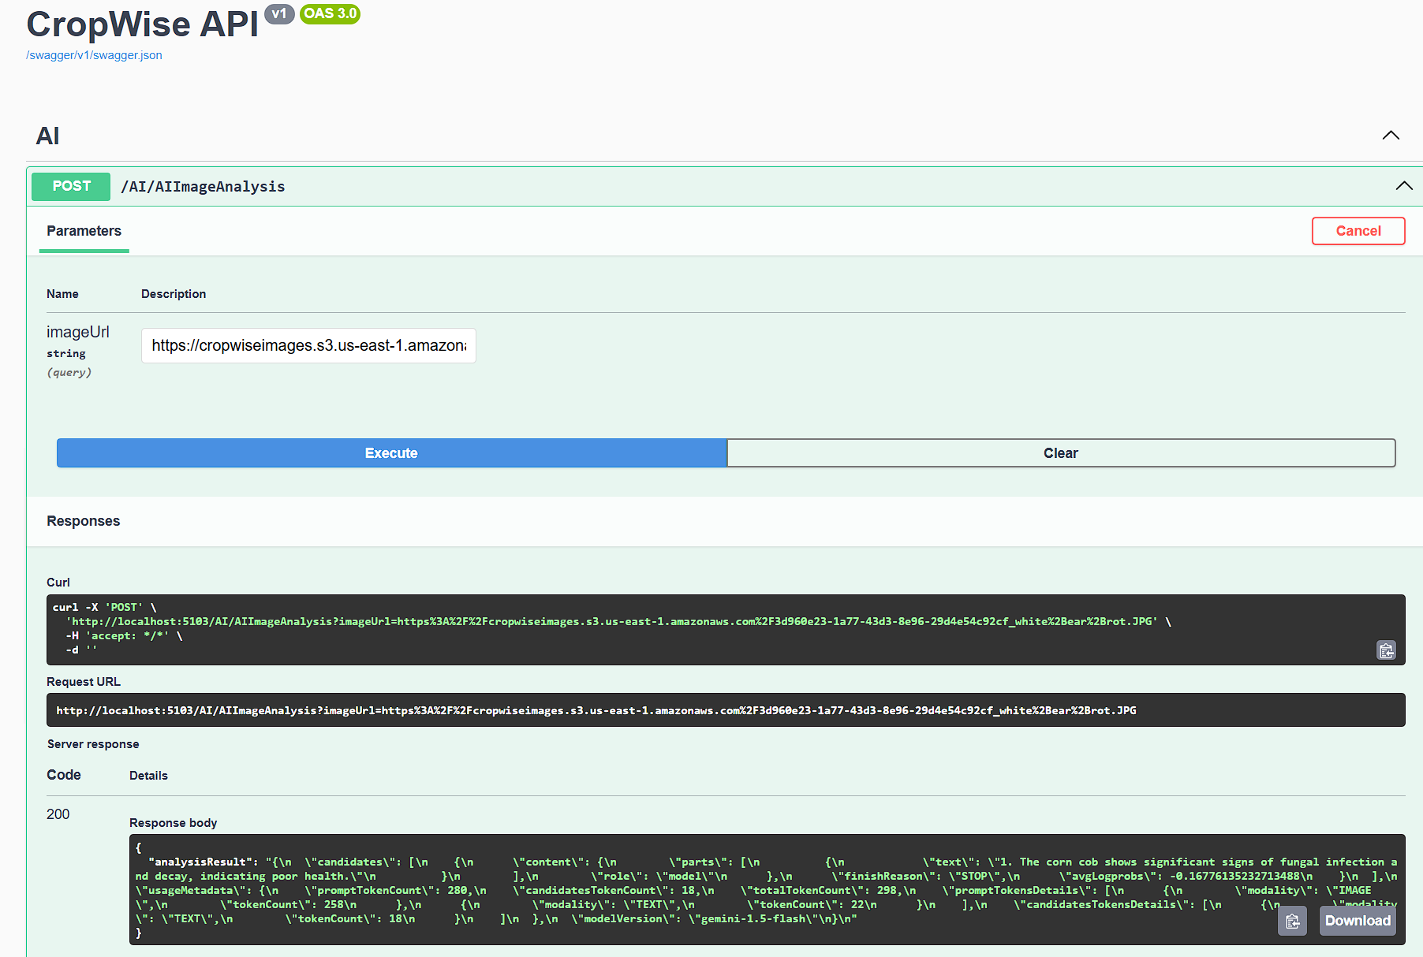
Backend progress (Crop Analyzer)
Crop image URI is pulled from s3 bucket and passed to Gemini API
Code 200: Good response from Gemini API

Slide 10
Backend progress (AI analysis)
Gemini API Analysis:
Crop Health (scale 1-5):- 1
Diagnosis: The corn cob shows significant signs of fungal infection and decay.
Recommendation:
Remove and destroy infected ears to prevent further spread of the fungus.
Rotate crops to non-susceptible hosts like soybeans or small grains for at least two years.
Choose resistant corn hybrids for future plantings to reduce disease incidence.
Gemini API response parsed using well tuned prompts.

Slide 11
Next Steps…
Adding more verified documents to Gemini API for more reliable recommendations.
Parsing Gemini response into good UI format for user.
Building separate soil analyzer workflow
Building unified recommender based an area climate and real time weather data as well as soil data.

Slide 12
THANK YOU

